Slide 1

3. Project Organization and Management

Slide 2
Outline
An Overview of Project Management
Project Management Activities
Software Life Cycle Model

Slide 3

1. An Overview of Project Management

Slide 4
1.1 History of Project Management
Some people argue that building the Egyptian pyramids was a project, as was building the Great Wall of China
Most people consider the Manhattan Project to be the first project to use “modern” project management
This three-year, $2 billion (in 1946 dollars) project had a separate project manager and a technical manager
Notes:
Money is less valuable than before

Slide 5
1.2 The Triple Constraint of Project Management
Every project is constrained in different ways by its:
Scope:
What work will be done as part of the project?
What unique product, service, or result does the customer or sponsor expect from the project?
How will the scope be verified?
Time:
How long should it take to complete the project?
What is the project’s schedule?
How will the team track actual schedule performance?
Who can approve changes to the schedule?

Slide 6
Every project is constrained in different ways by its:
Cost:
What should it cost to complete the project?
What is the project’s budget?
How will costs be tracked?
Who can authorize changes to the budget?
It is the project manager’s duty to balance these three often competing goals.

Slide 7
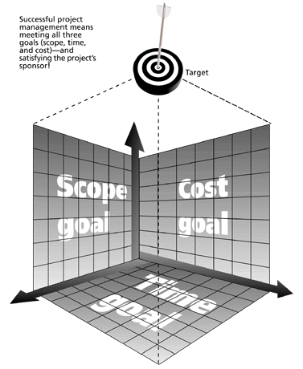
Successful project management means meeting all three goals (scope, time, and cost) – and satisfying the project’s sponsor!

Slide 8
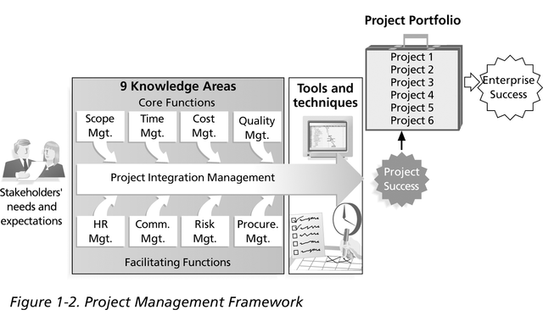
1.3 Project Management Framework

Slide 9
1.4 Tasks and Work Products
A task is a well-defined work assignment for a role
A work product is a tangible item that results from a task
An object model
A class diagram
A piece of source code
A document
…

Slide 10
Work
*
Task
Activity
«invariant»
Project Function
duration = project.duration

Slide 11
Work Products, Work Packages, and Roles
Work Package: A description of the work products to be produced, the resource needed, duration (expected), work produces and dependencies
Work Package
describes
*
*
produced-by
Outcome
Work
*
Set of Work Products
Work Product
Task
Activity
Internal Work Product
Project Deliverable
Project Function
Notes:
We assign them to participants to do the work.
An example of a small work package is an action item, which contains only the name of the participant, the description of the task, the time needed.
Any work product to be delivered to the customer is called a deliverable

Slide 12
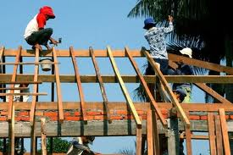
Example: Let‘s Build a House
What are the activities that are needed to build a house?

Slide 13
What is the problem?
Your boss: “How long will this take?”
You: “Between 1 and 6 months.”
People are not happy when you respond that way.
You figure out that finishing anytime before six months will meet your promise.
Your boss figures that with some hard work you can be done in a month!
In reality, you don’t have the slightest clue how long it will take, because you don’t know the work to be done.
Solution: Use divide and conquer
To give a good answer you have to break the work down into activities for which you can get good timing estimates
From these estimates you compute the estimated project duration

Slide 14
Activities to obtain good time estimates
Identify the work that needs to be done
Work breakdown structure (WBS)
Identify the dependency between work units
Dependency Graph
Estimate the duration of the work to be done
Schedule

Slide 15
Typical activities when building a house
Surveying
Excavation
Request Permits
Buy Material
Lay foundation
Build Outside Wall
Install Exterior Plumbing
Install Exterior Electrical
Install Interior Plumbing
Install Interior Electrical
Install Wallboard
Paint Interior
Install Interior Doors
Install Floor
Install Roof
Install Exterior Doors
Paint Exterior
Install Exterior Siding
Buy Pizza
Finding these activities is a brainstorming activity.
It requires similar activities used during analysis (use case modeling)

Slide 16
Hierarchical organization of the activities
Building the house consists of
Prepare the building site
Building the Exterior
Building the Interior
Preparing the building site consists of
Surveying
Excavation
Buying of material
Laying of the foundation
Requesting permits

Slide 17
Partial Work Breakdown Structure
Notes:
[ˈplʌmɪŋ]
Sewer pipes 下水道

Slide 18
From the WBS to the Dependency Graph
The work breakdown structure does not show any temporal dependence among the activities/tasks
Can we excavate before getting the permit?
How much time does the whole project need if I know the individual times?
What can be done in parallel?
Are there any critical actitivites, that can slow down the project significantly?
Temporal dependencies are shown in the dependency graph
Nodes are activities
Lines represent temporal dependencies

Slide 19
Building a House (Dependency Graph)
Install
Install
Install
The activity
„Buy Material“ must
Precede the activity
„Lay foundation“
Interior
Interior
Wallboard
Plumbing
Electrical
Paint
Interior
Install
Install
Interior
Flooring
Doors
START
Survey
Excava
Buy
Lay
Build
FINISH
ing
tion
Material
Founda
Outside
tion
Wall
Install
Roofing
Install
Exterior
Doors
Request
Paint
Exterior
Install
Install
Install
Exterior
Exterior
Exterior
Plumbing
Electrical
Siding

Slide 20
Building a House (PERT Chart)
Each Activity has a start time and an estimated duration
12/3/94
12/21/94
1/11/95
Install
Install
Install
Interior
Interior
Wallboard
Plumbing
Electrical
0
0
0
1/22/95
12
15
9
Paint
Interior
0
2/8/95
11
Install
1/22/95
Interior
Install
Doors
Flooring
0
8/27/94
8/27/94
9/17/94
10/1/94
10/15/94
11/5/94
0
7
2/16/95
START
Survey
Excava
Buy
Lay
Build
1/19/95
18
FINISH
ing
tion
Material
Founda
Outside
tion
Wall
Install
1/19/95
0
12
0
0
0
0
Roofing
0
0
3
10
10
15
20
12
Install
0
9
Exterior
8/27/94
Doors
Request
1/12/95
15
Permits
Paint
6
0
Exterior
15
12
5
12/3/94
12/17/94
12/31/94
Start Time
8/29/94
Install
Install
Install
Exterior
Exterior
Exterior
Legend
Plumbing
Electrical
Siding
Duration
0
12
12
12
Slack Time
0
10
10
8

Slide 21
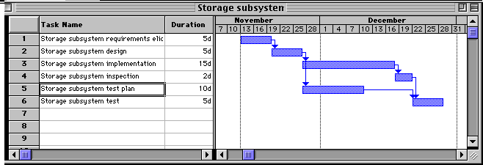

Slide 22
Model of a Project from a project manager’s point of view.
Equipment
Project
*
Facility
Resource
Fund
Work
*
Organi-
Breakdown
des-
zation
Schedule
Structure
cribes
Work
Package
*
con-
*
*
sumes
*
produces
Organizational
Outcome
Work
respon-
Unit
*
*
sible
*
depends
for
plays
Role
Set of Work
Work
Activity
Task
Participant
Staff
Products
Product
Internal
Project
Project Function
Department
Team
Work Product
Deliverable

Slide 23
1.5 Project Agreement, Problem Statement vs SPMP

Slide 24
Project Agreement
Document written for a client that defines:
the scope, duration, cost and deliverables for the project.
the exact items, quantities, delivery dates, delivery location.
Client: Individual or organization that specifies the requirements and accepts the project deliverables.
Can be a contract, a statement of work, a business plan, or a project charter.
Deliverables (= Work Products that will be delivered to the client:
Documents
Demonstrations of function
Demonstration of nonfunctional requirements
Demonstrations of subsystems

Slide 25
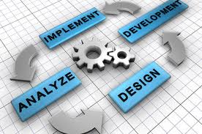
2. Project Management Activities

Slide 26
2.1 Four Management Activities
Planning the Project
Organizing the Project
Controlling the Project
Terminating the Project

Slide 27
2.2 Planning the Project
Deliverables
Project Planning Products
Project Agreement
Problem Statement
Requirements Analysis
Document (RAD)
Top-level Design
System Design
Document (SDD)
Organization
Software Project
Task Model
Management Plan (SPMP)
Schedule
Notes:
Problem statement: a short document describing the problem the system should address, the target environment, client deliverables, and acceptance criteria
Top-level design: it represents the initial decomposition of the system into subsystems
SPMP: all the managerial aspects of the project

Slide 28
2.3 Organizing the Project
Setting up the communication infrastructure
Schedule Modes
Event-based modes
Identifying skills
Application domain skills
Communication skills
Technical skills
Quality skills
Management skills

Slide 29
Assigning management roles
Assigning technical roles
Dealing with skill shortages
Selecting team sizes
Assembling the teams
Kick-off meeting
Agreeing on project scope

Slide 30
2.4 Controlling the Project
Decision making relying on collecting accurate status information
Meetings
Sharp milestones
Project reviews
Code inspections
Prototype demonstration

Slide 31
Metrics
Financial status
Technical progress
Stability
Modularity
Maturity

Slide 32
2.5 Terminating the Project
Accepting the system
The presentation of the system and the approval of the client according to acceptance criteria set forth in the Project Agreement
Installation
It includes the field test of the system, the comparison of the system results with the legacy system, the rollout of the legacy system, and the training of users
Postmortem
Each project provides a chance for learning

Slide 33
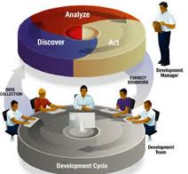
3. Software Life Cycle Model

Slide 34
A software life cycle model represents all the activities and work products necessary to develop a software system

Slide 35
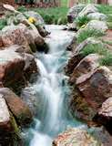
The waterfall model of software development is an activity-centered view of the software life cycle.
Project
Initiation
Process
Concept
Exploration
Process
System
Allocation
Process
Requirements
Process
Design
Process
Implementation
Process
Verification
& Validation
Process
Installation
Process
Operation &
Support Process

Slide 36
V-Model of software development.
System
Requirements
Operation
Analysis
Software
Client
Requirements
Acceptance
Elicitation
Requirements
System
Analysis
Integration
& Test
Preliminary
Component
Design
Integration
& Test
Detailed
Unit
Design
Test
Implementation

Slide 37
Boehm’s spiral model (Adapted from [Boehm, 1987]).
Notes:
This model of development combines the features of the prototyping model and the waterfall model. The spiral model is favored for large, expensive, and complicated projects.
The final system is constructed, based on the refined prototype

Slide 38
Workflows in the unified software life cycle
Unified Process Model
Management
Unified Process
Environment
Software Life Cycle
releases
Product
Requirements
*
Design
Workflow
*
Cycle
Implementation
Inception
4
Assessment
Phase
Elaboration
Deployment
*
Construction
Artifact
*
Iteration
Transition

Slide 39
States of a Software System called phases in the Unified Process.
Inception
Elaboration
Transition
Construction

Slide 40
The seven workflows in the Unified Process.

Slide 41
Capability Maturity Model (CMM)
CMM was developed at the Software Engineering Institute (SEI) at Carnegie-Melon University in Pittsburgh, PA, funded largely by the U.S. Defense Department.
CMM is design to measure, and thereby improve, the process of software development.
SEI establishes standards; it does not perform evaluations of individual firms.
Evaluations of firms are done by third parties; these third-party evaluators have varying degrees of expertise and creditability.
The highest level of CMM is Level Five; less than a hundred organizations in the world are certified as Level Five.
CMM is similar to ISO 9000 and 9001; but while CMM focuses primarily on improving performance, ISO 9000 and 9001 focus on establishing and maintaining careful documentation, procedures, and standards.

Slide 42

What are the Five Levels of CMM?
Initial – poorly controlled; ad hoc; difficult to repeat successful activities; dependent upon the skills of the individual developers
Repeatable – disciplined processes; can repeat successful activities and tasks; developers learn from each other
Defined – standard, consistent processes; a database of development “best practices” is created and maintained; these “best practice” are readily available and understood
Managed – all development activities follow these corporate “best practices”; compliance with these development standards is mandatory
Optimizing – continuous process of seeking out best practices from around the world; active, continuous improvement

Slide 43
Summary
Software development as a Project
Project Management is a modern approach to coordinate complex task teams
There are different Software Life Cycle Models with different characteristics.

Slide 44
Thanks cao-jian@cs.sjtu.edu.cn
Some materials come from Bernd Bruegge’s PPT, others from Internet
csis.pace.e

